Slide 1
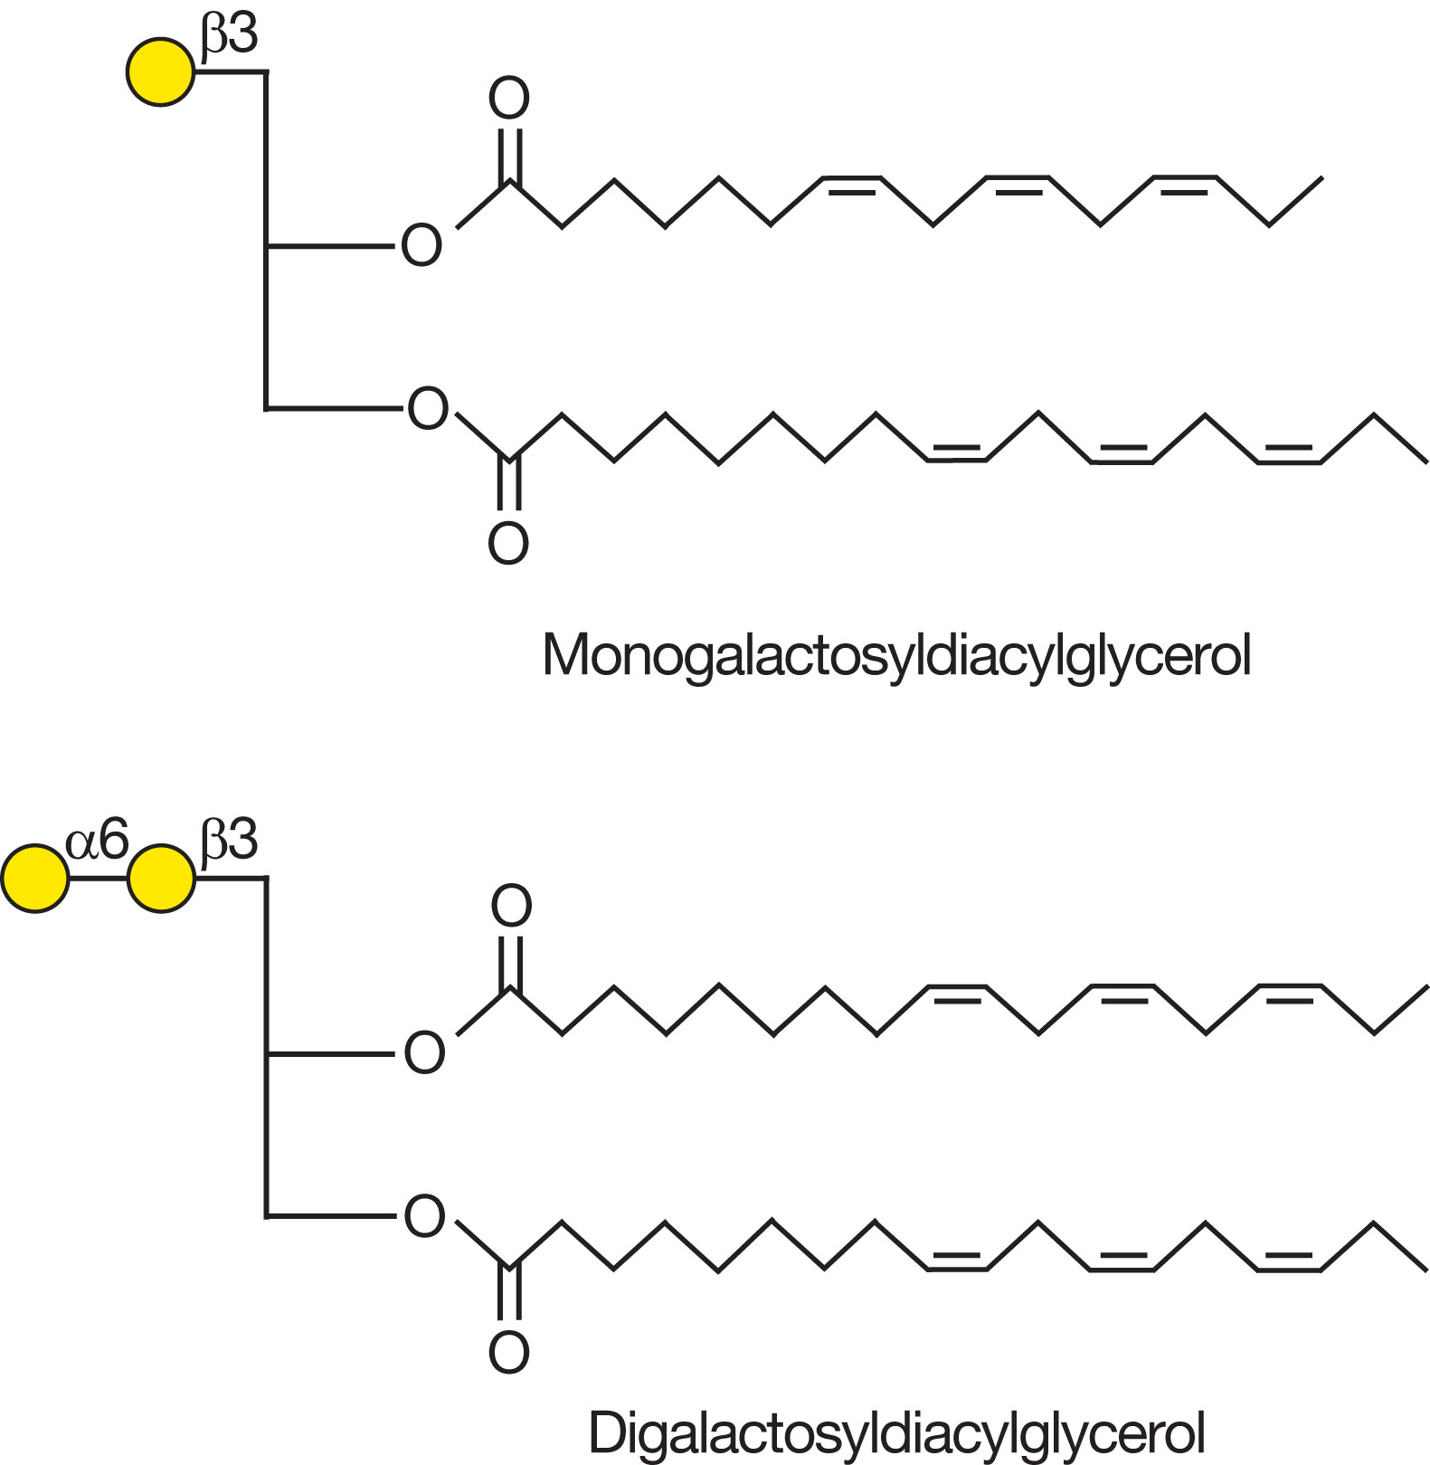
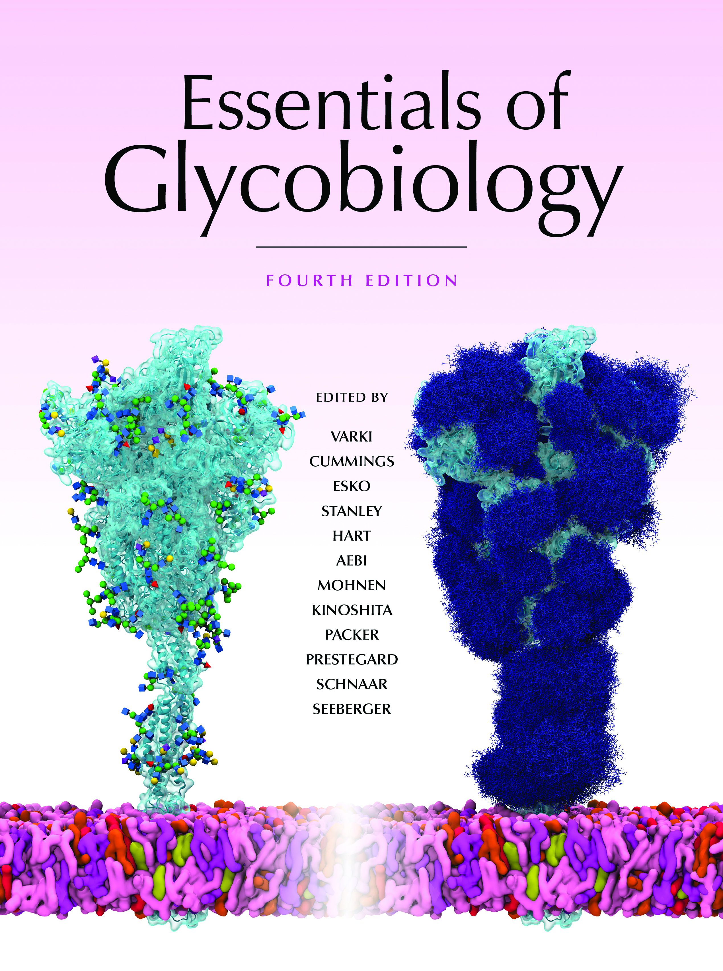
The Most Abundant Plant Galactolipids
Chapter 24, Figure 6. Essentials of Glycobiology, Fourth Edition
Click here for Symbol Nomenclature for Glycans (SNFG) (Live only in slide display mode)
Buy the Book
©2022 The Consortium of Glycobiology Editors, La Jolla, California
Notes:
(Note: Embedded links are present but live only in the slide display mode.)
FIGURE 24.6. The most abundant plant galactolipids.

