Slide 1
How To: Download a list of human, clinical E. faecailis isolates
NCBI Pathogen Detection https://www.ncbi.nlm.nih.gov/pathogens

Slide 2
How do I find only human, clinical E. faecailis isolates?
Use the Isolates Browser
Use filters or search to select Organism Group “Enterococcus faecalis”
Use filters or search to select Isolation Type “clinical”
Download table

Slide 3
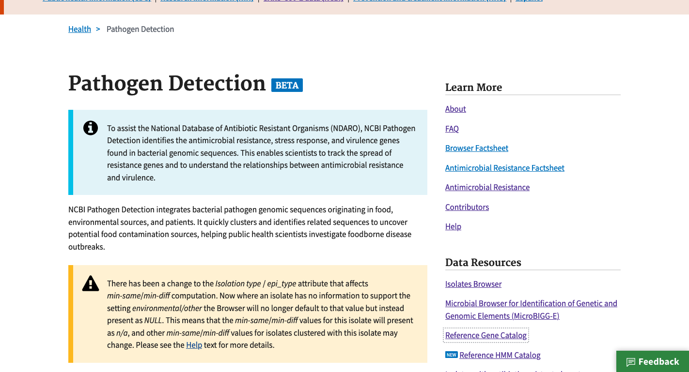
https://www.ncbi.nlm.nih.gov/pathogens
1. Click Isolate Browser

Slide 4
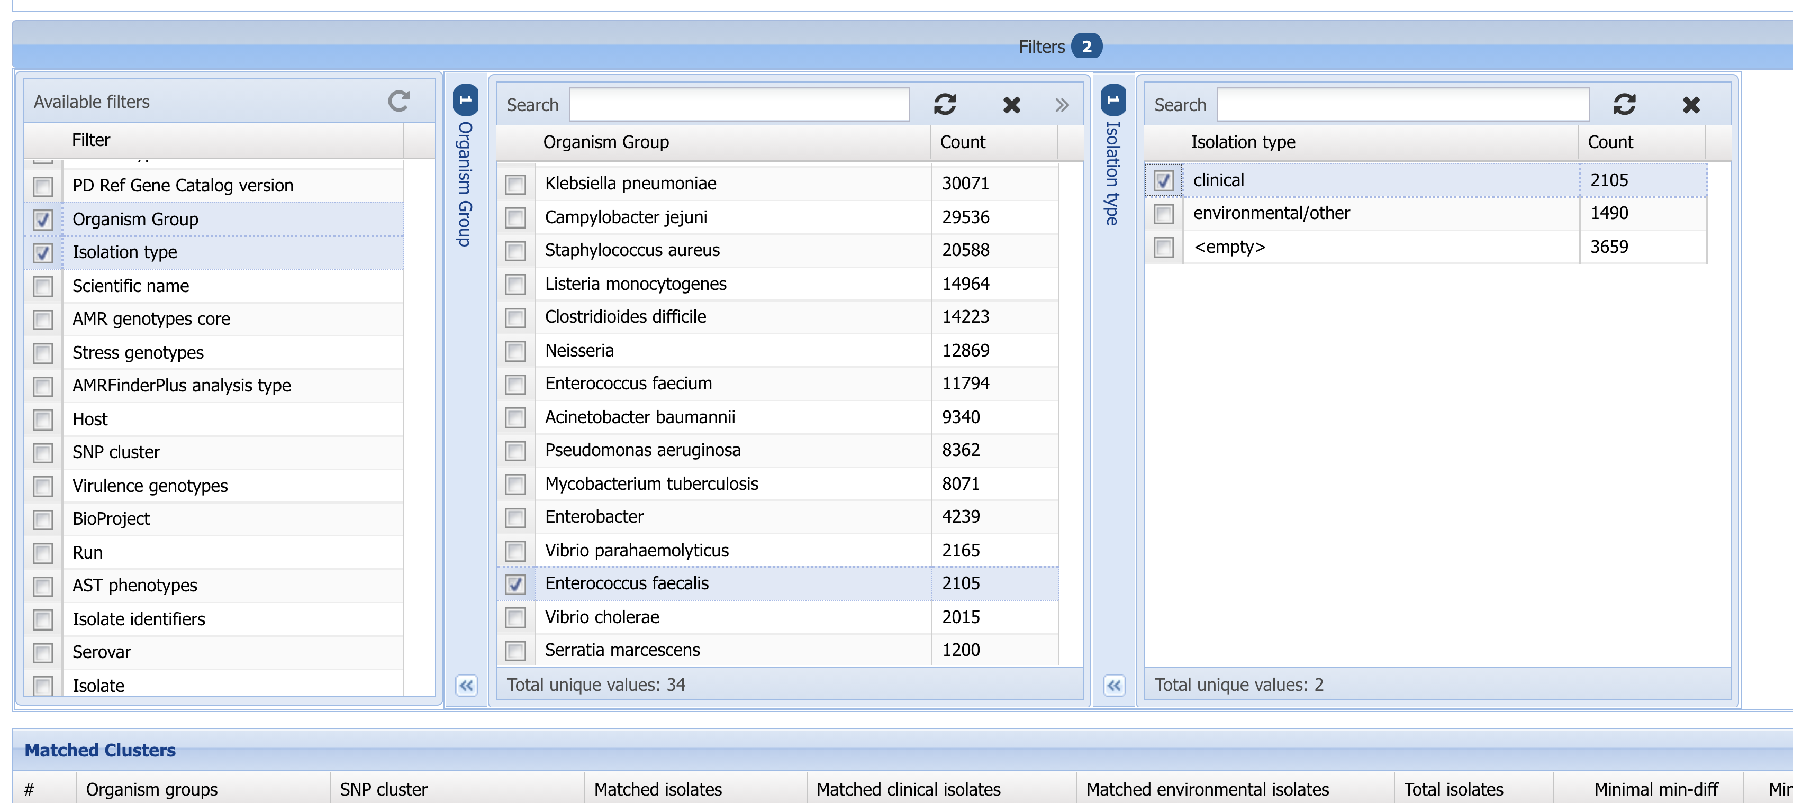
2. Click Filters bar to show filters
3. Click Organism Group and Isolation Type to show organism group and isolation type filters
6. Select clinical
5. NOTE: some Organism groups contain multiple species. You can use Scientific name to further refine your search
4. Select Enterococcus faecalis.

Slide 5
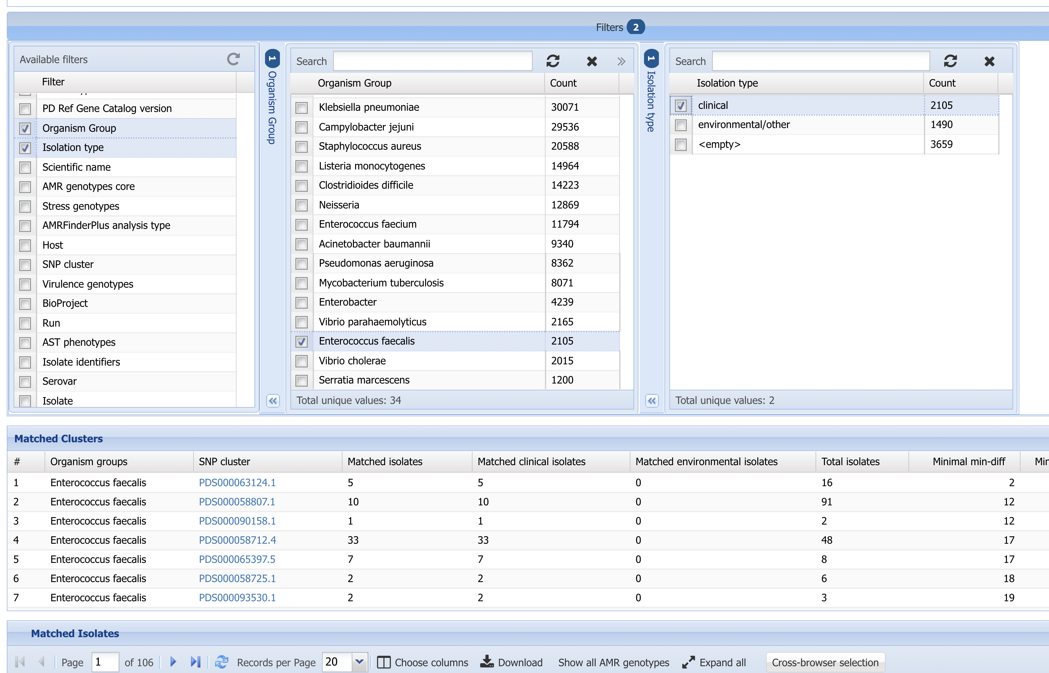
7. Click Download button

Slide 6
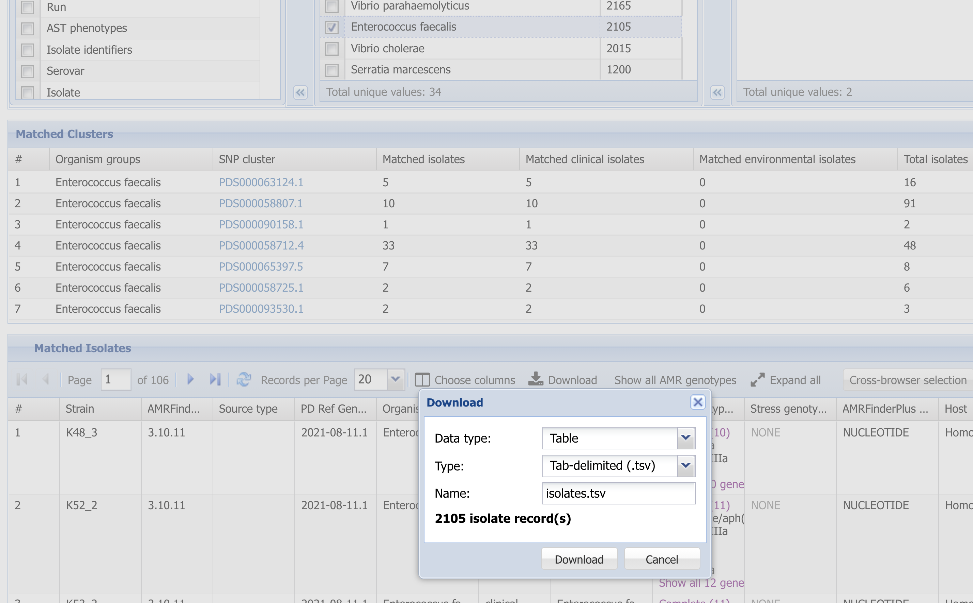
9. Can edit the name of the download file
8. Click Download to get data in tab-delimited format

Slide 7
More information
For full help documentation of the Reference Gene Catalog see: https://www.ncbi.nlm.nih.gov/pathogens/pathogens_help/#reference-gene-catalog
For details about filters see:
https://www.ncbi.nlm.nih.gov/pathogens/pathogens_help/#refgene-filters
For details about the table downloads see:
https://www.ncbi.nlm.nih.gov/pathogens/pathogens_help/#refgene-access-download
Questions and further help: email pd-help@ncbi.nlm.nih.gov

