Slide 1
How To: Download a list of all carbapenem resistance genes and point mutations from the Reference Gene Catalog
NCBI Pathogen Detection https://www.ncbi.nlm.nih.gov/pathogens

Slide 2
At a glance
Use Reference Gene Catalog
https://www.ncbi.nlm.nih.gov/pathogens/refgene
Use filters or search to select Subclass “CARBAPENEM”
Download table

Slide 3
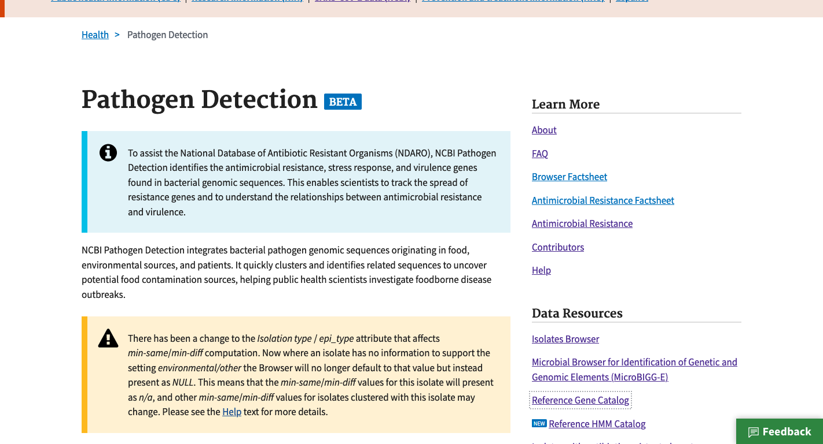
https://www.ncbi.nlm.nih.gov/pathogens
1. Click Reference Gene Catalog

Slide 4
https://www.ncbi.nlm.nih.gov/pathogens/refgene
2. Click Filters bar to show filters
4. Select CARBAPENEM
3. Click subclass to show subclass filter

Slide 5
https://www.ncbi.nlm.nih.gov/pathogens/refgene
5. Click Download button

Slide 6
https://www.ncbi.nlm.nih.gov/pathogens/refgene
6. Click Download to get data in tab-delimited format

Slide 7
More information
For full help documentation of the Reference Gene Catalog see: https://www.ncbi.nlm.nih.gov/pathogens/pathogens_help/#reference-gene-catalog
For details about filters see:
https://www.ncbi.nlm.nih.gov/pathogens/pathogens_help/#refgene-filters
For details about the table downloads see:
https://www.ncbi.nlm.nih.gov/pathogens/pathogens_help/#refgene-access-download
Questions and further help: email pd-help@ncbi.nlm.nih.gov

