Slide 1
How To: Download a MicroBIGG-E table > 100,000 rows (all CARBAPENEM genes found in Pathogen Detection isolate assemblies)
NCBI Pathogen Detection https://www.ncbi.nlm.nih.gov/pathogens

Slide 2
At a glance
Use MicroBIGG-E
https://www.ncbi.nlm.nih.gov/pathogens/microbigge
Use filters or search to select rows of interest, in this case subclass:CARBAPENEM
Subdivide the search into sets with < 100,000 rows to download in batches
  Use filters to get results under 100,000 rows
  Download one file
  Change filters to get different results under 100,000 rows
  Download second file
  Repeat above steps as needed to get the entire set

Slide 3
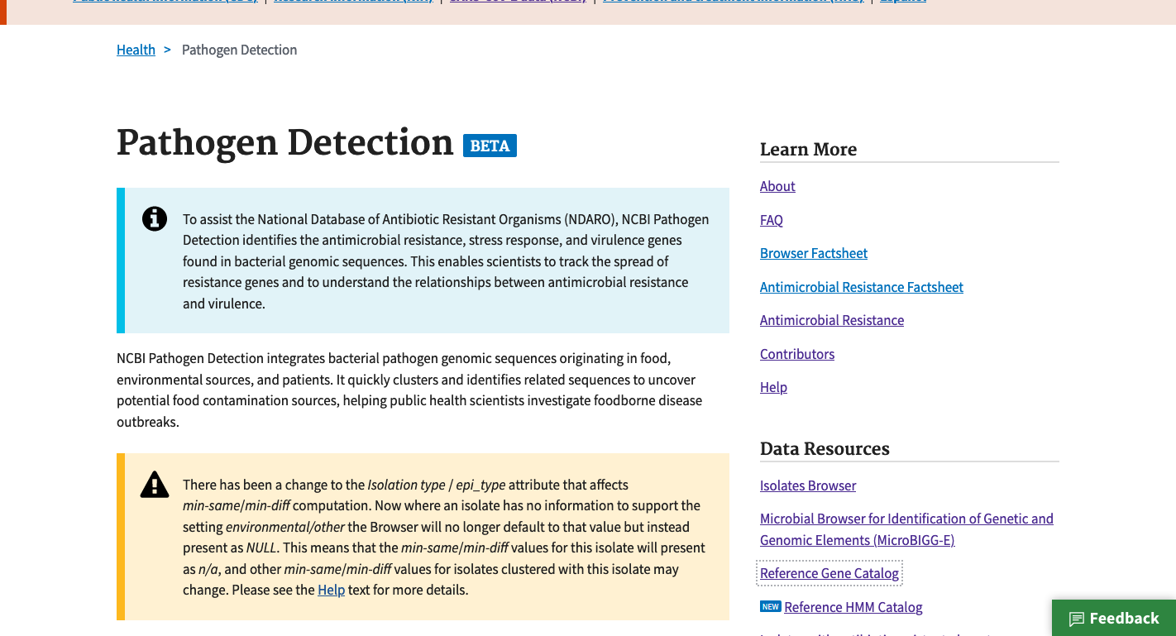
https://www.ncbi.nlm.nih.gov/pathogens
1. Click MicroBIGG-E

Slide 4
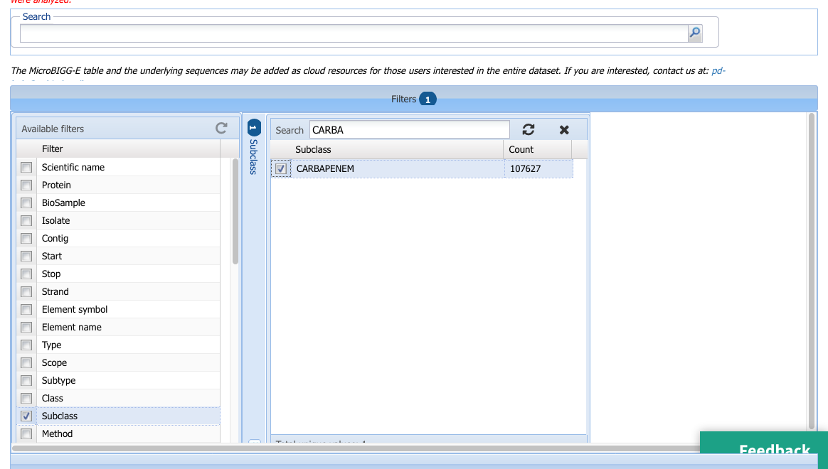
2. Click Filters bar to show filters
https://www.ncbi.nlm.nih.gov/pathogens/microbigge
4. Start typing CARBAPENEM to reveal the value
5. Select CARBAPENEM filter
6. Note > 100,000 results
3. Click subclass to show subclass filter

Slide 5
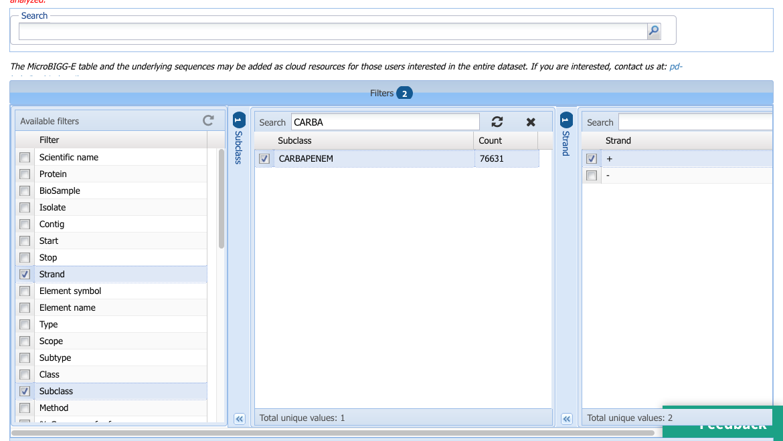
https://www.ncbi.nlm.nih.gov/pathogens/microbigge
7. Select another filter to subset the results

Slide 6
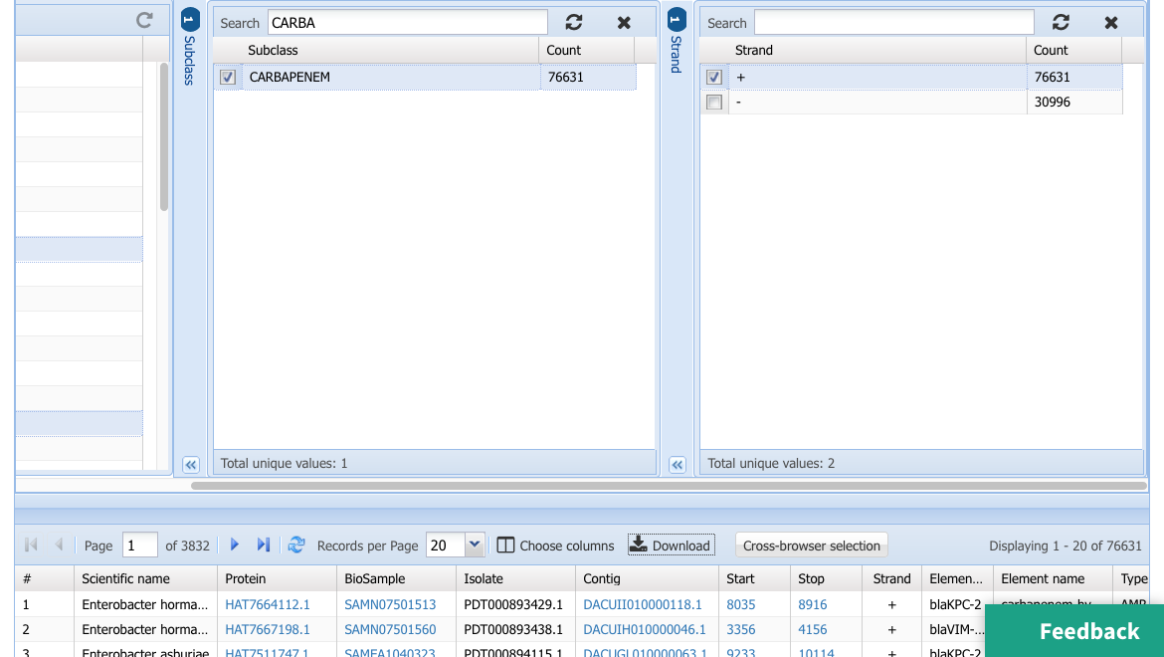
https://www.ncbi.nlm.nih.gov/pathogens/microbigge
8. Select one or more of the options
9. Note that total selected is less than 100,000
10. Click Download button to open download options

Slide 7
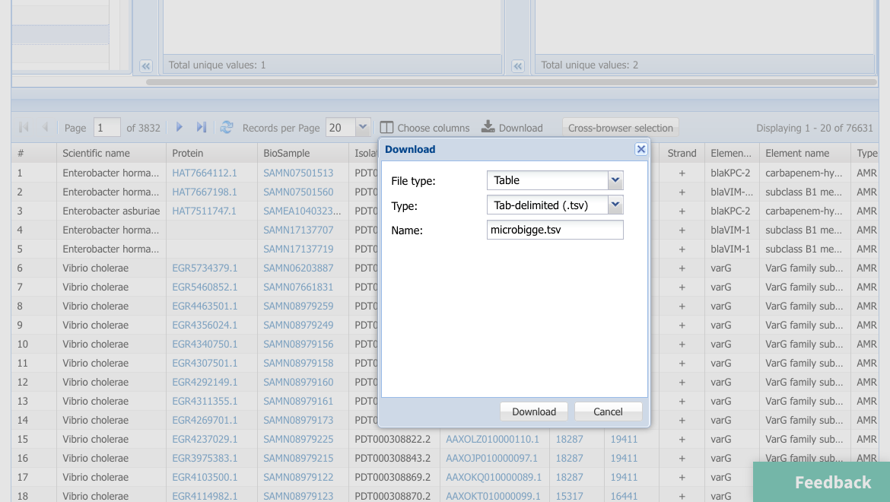
https://www.ncbi.nlm.nih.gov/pathogens/microbigge
11. Click Download button to download table

Slide 8
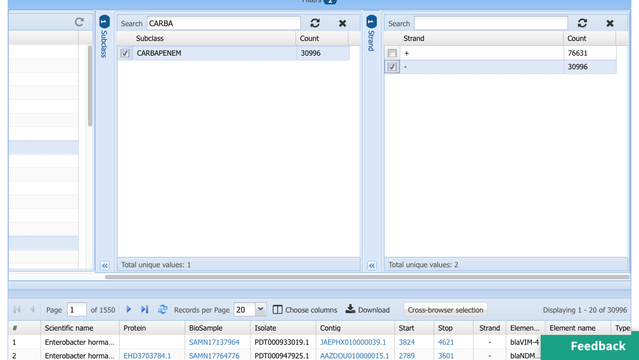
https://www.ncbi.nlm.nih.gov/pathogens/microbigge
12. Deselect the previous filter value
13. Select an alternate to get a different subset of the total rows
14. Note that total selected is less than 100,000
15. Click Download to open download options

Slide 9
https://www.ncbi.nlm.nih.gov/pathogens/microbigge
16. Click Download button to download table

Slide 10
More information
For full help documentation of the Reference Gene Catalog see: https://www.ncbi.nlm.nih.gov/pathogens/pathogens_help/#microbigge
For details about filters see:
https://www.ncbi.nlm.nih.gov/pathogens/pathogens_help/#microbigge-filters
For details about the table downloads see:
https://www.ncbi.nlm.nih.gov/pathogens/pathogens_help/#microbigge-access-download
Questions and further help: email pd-help@ncbi.nlm.nih.gov

