Slide 1
How To: Find an isolate you submitted
NCBI Pathogen Detection https://www.ncbi.nlm.nih.gov/pathogens

Slide 2
At a glance
Use the Pathogen Isolates Browser to locate your isolate
https://www.ncbi.nlm.nih.gov/pathogens
Check the exceptions report
Check the Submission Portal
Ask for help

Slide 3
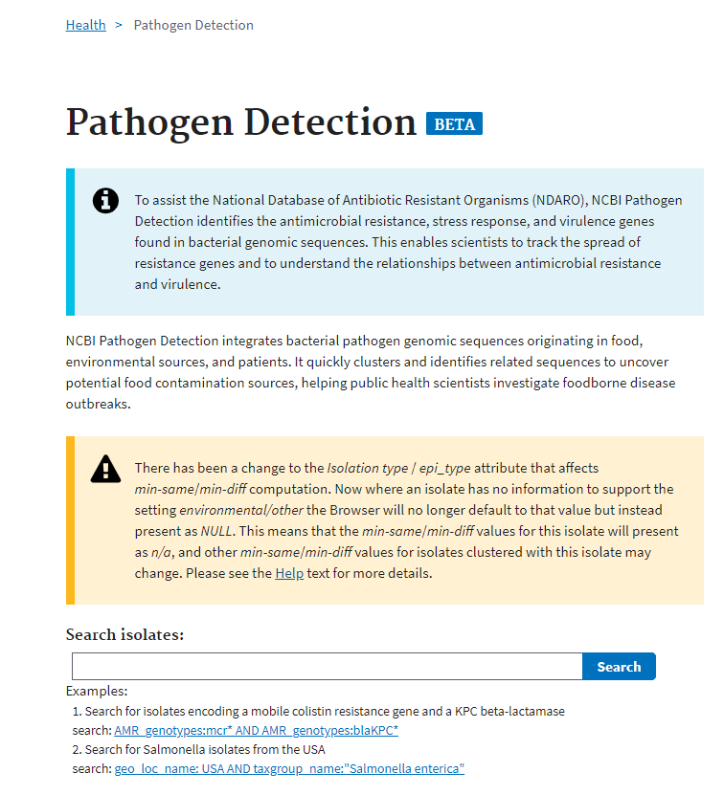
https://www.ncbi.nlm.nih.gov/pathogens
Searches:
By biosample | biosample_acc: SAMN02921631
By strain or isolate name | isolate_identifiers: CFSAN019912
By SRA run | Run: SRR13415101
By bioproject | bioproject_acc: PRJNA215355
By assembly | asm_acc: GCA_016619445.2 or wgs_acc_prefix: AAYRYS
By pathogen record creation date (when the record was received by Pathogen) | creation_date: [2021-03-23 TO 2021-03-25] or taxgroup_name:"Listeria monocytogenes" AND new:1
1. Search the Isolates Browser
Searches can usually be entered without the prefix <search term>:
You can also drop lists of identifiers into the search box

Slide 4
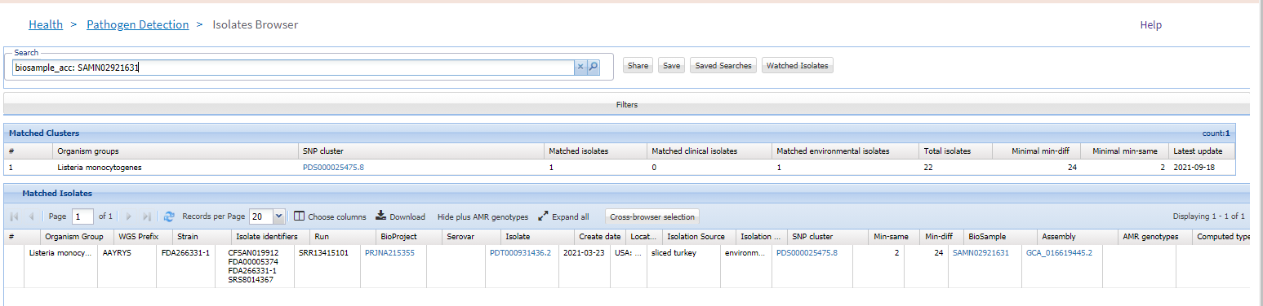
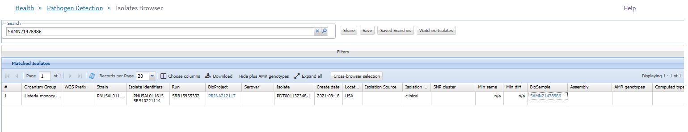
Isolate is found in Browser
https://www.ncbi.nlm.nih.gov/pathogens/isolates
2. Normal result.
3a. Follow link to its position in the cluster
3b. This isolate didn’t cluster

Slide 5
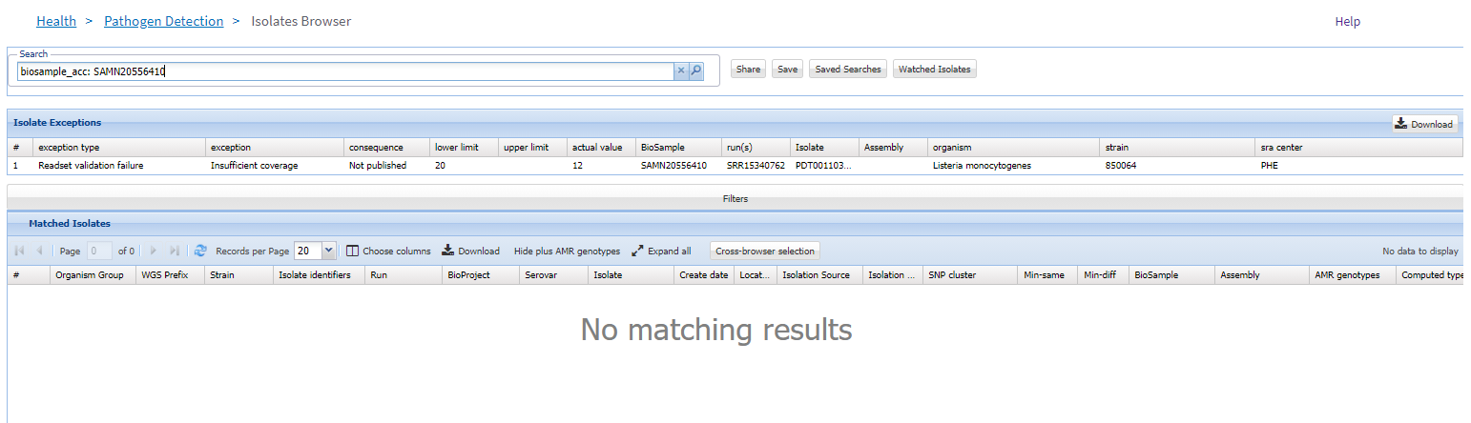
Isolate is found in Browser - 2
https://www.ncbi.nlm.nih.gov/pathogens/isolates
4. The searched isolate is found, but not in the regular results. It had an “exception”, meaning something was wrong with the data and it couldn’t be used.
More about pathogen isolate exceptions...

Slide 6
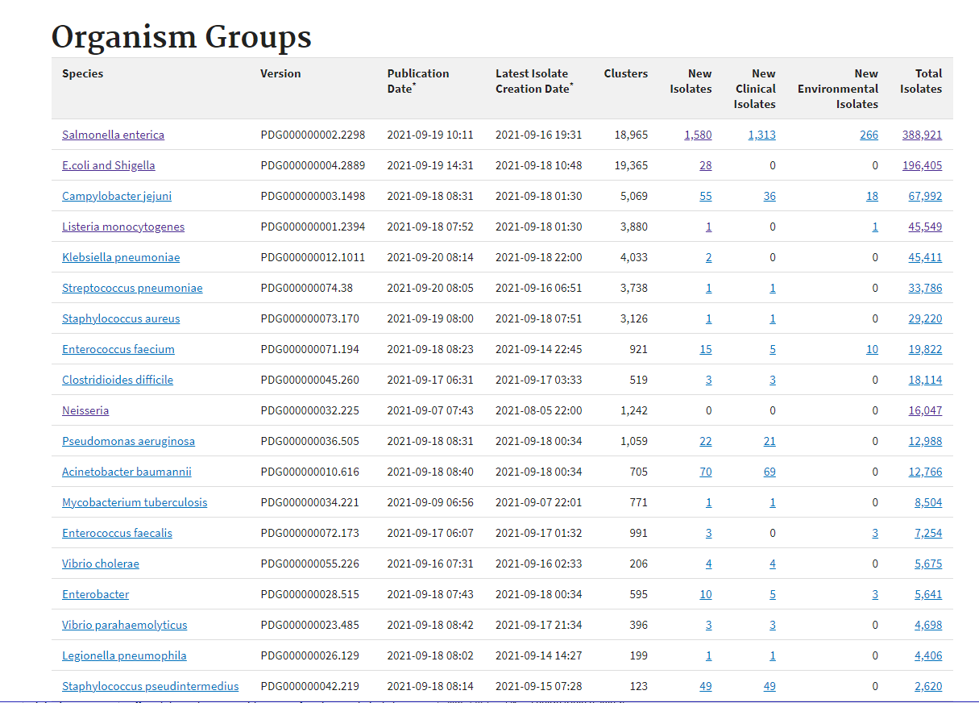
Isolate not found
https://www.ncbi.nlm.nih.gov/pathogens/organisms/
5. Check the Latest Isolate Creation Date, is it before the date when your isolate was submitted?
If not then you should wait for the next publication. Check back on this page.
Note: Salmonella in particular can take several days to recompute.

Slide 7
Isolate not found
Things to check if you still can’t find it:
Is the isolate found in NCBI Entrez BioSample?
https://www.ncbi.nlm.nih.gov/biosample/SAMN21478986
If not, then check the Submission Portal
https://submit.ncbi.nlm.nih.gov/
If so, then have you registered your bioproject with the Pathogen project ? This is necessary for the system to “listen for” new isolates from your project.
  To register send a request to pd-help@ncbi.nlm.nih.gov
Still having problems? Write to pd-help@ncbi.nlm.nih.gov

Slide 8
More information
For full help documentation of the Pathogen Isolates Browser: https://www.ncbi.nlm.nih.gov/pathogens/pathogens_help/#isolates-browser
For Submission Portal documentation on SRA:
https://submit.ncbi.nlm.nih.gov/about/sra/
For Submission Portal documentation on WGS or Complete Genome submission: https://submit.ncbi.nlm.nih.gov/about/genome/
Questions and further help: email pd-help@ncbi.nlm.nih.gov

