Slide 1
How To: Identify isolates that have a pair of genes on the same contig (e.g., blaTEM-1 and blaKPC-4)
NCBI Pathogen Detection https://www.ncbi.nlm.nih.gov/pathogens

Slide 2
How do I identify isolates that have a pair of genes on the same contig? (e.g., blaTEM-1 and blaKPC-4)
Use MicroBIGG-E
Use the search term genes_on_contig “genes_on_contig:blaTEM-1 AND genes_on_contig:blaKPC-4”
Use Cross-browser selection to view all isolates with these two genes in the Isolates Browser
Download isolate metadata file

Slide 3
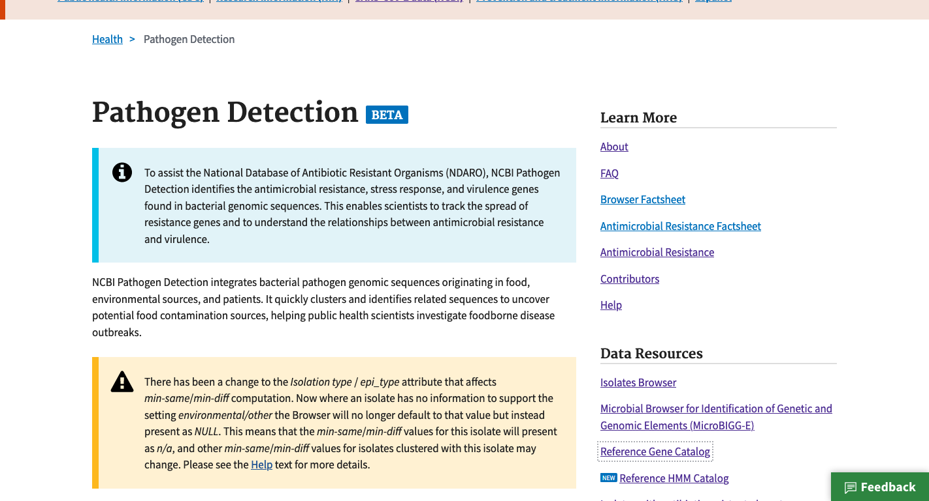
https://www.ncbi.nlm.nih.gov/pathogens
1. Click MicroBIGG-E

Slide 4
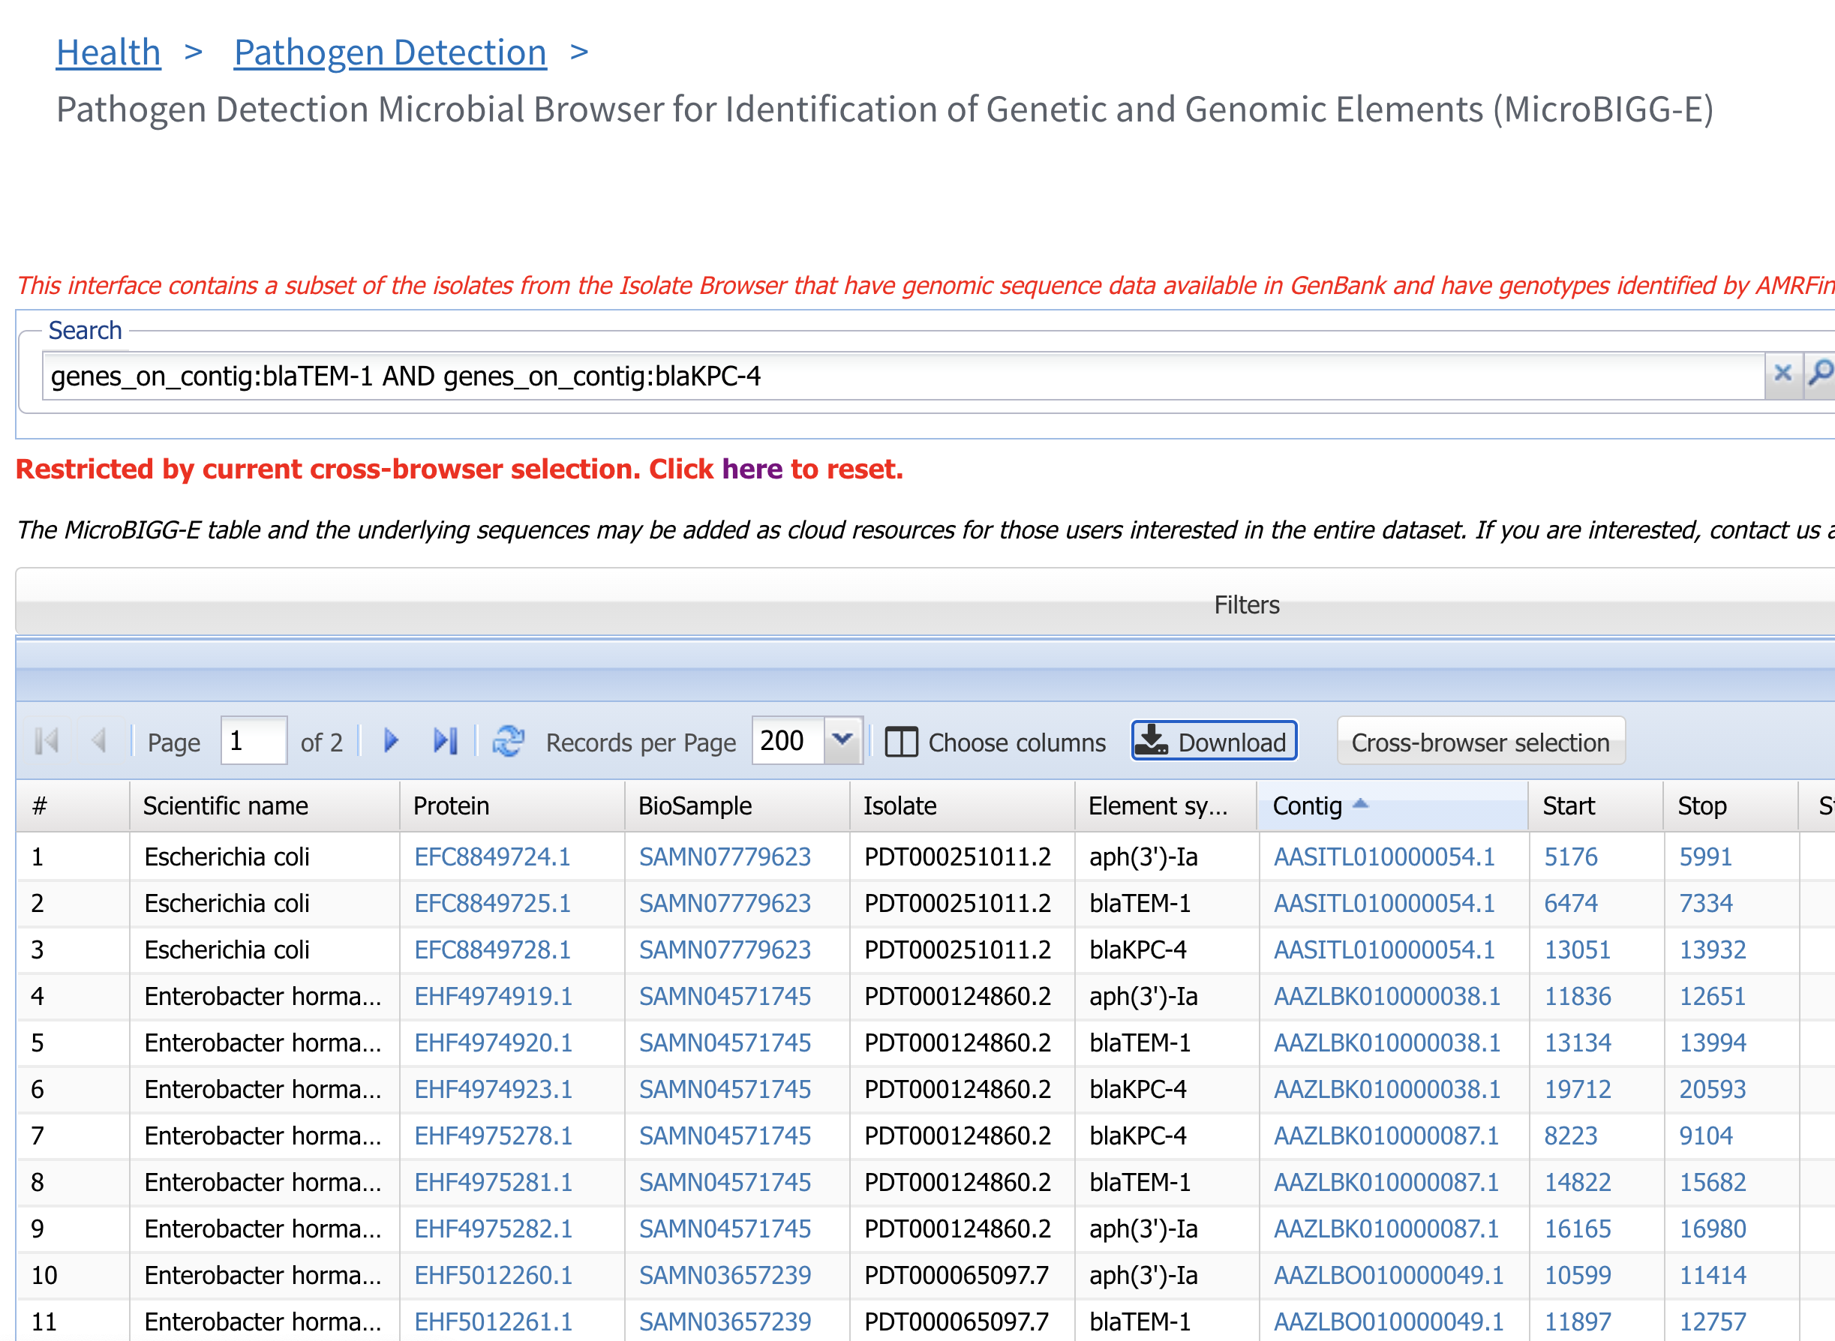
2. Use genes_on_contig command to identify contigs with blaTEM-1 and blaKPC-4
3. Click Cross-browser selection

Slide 5
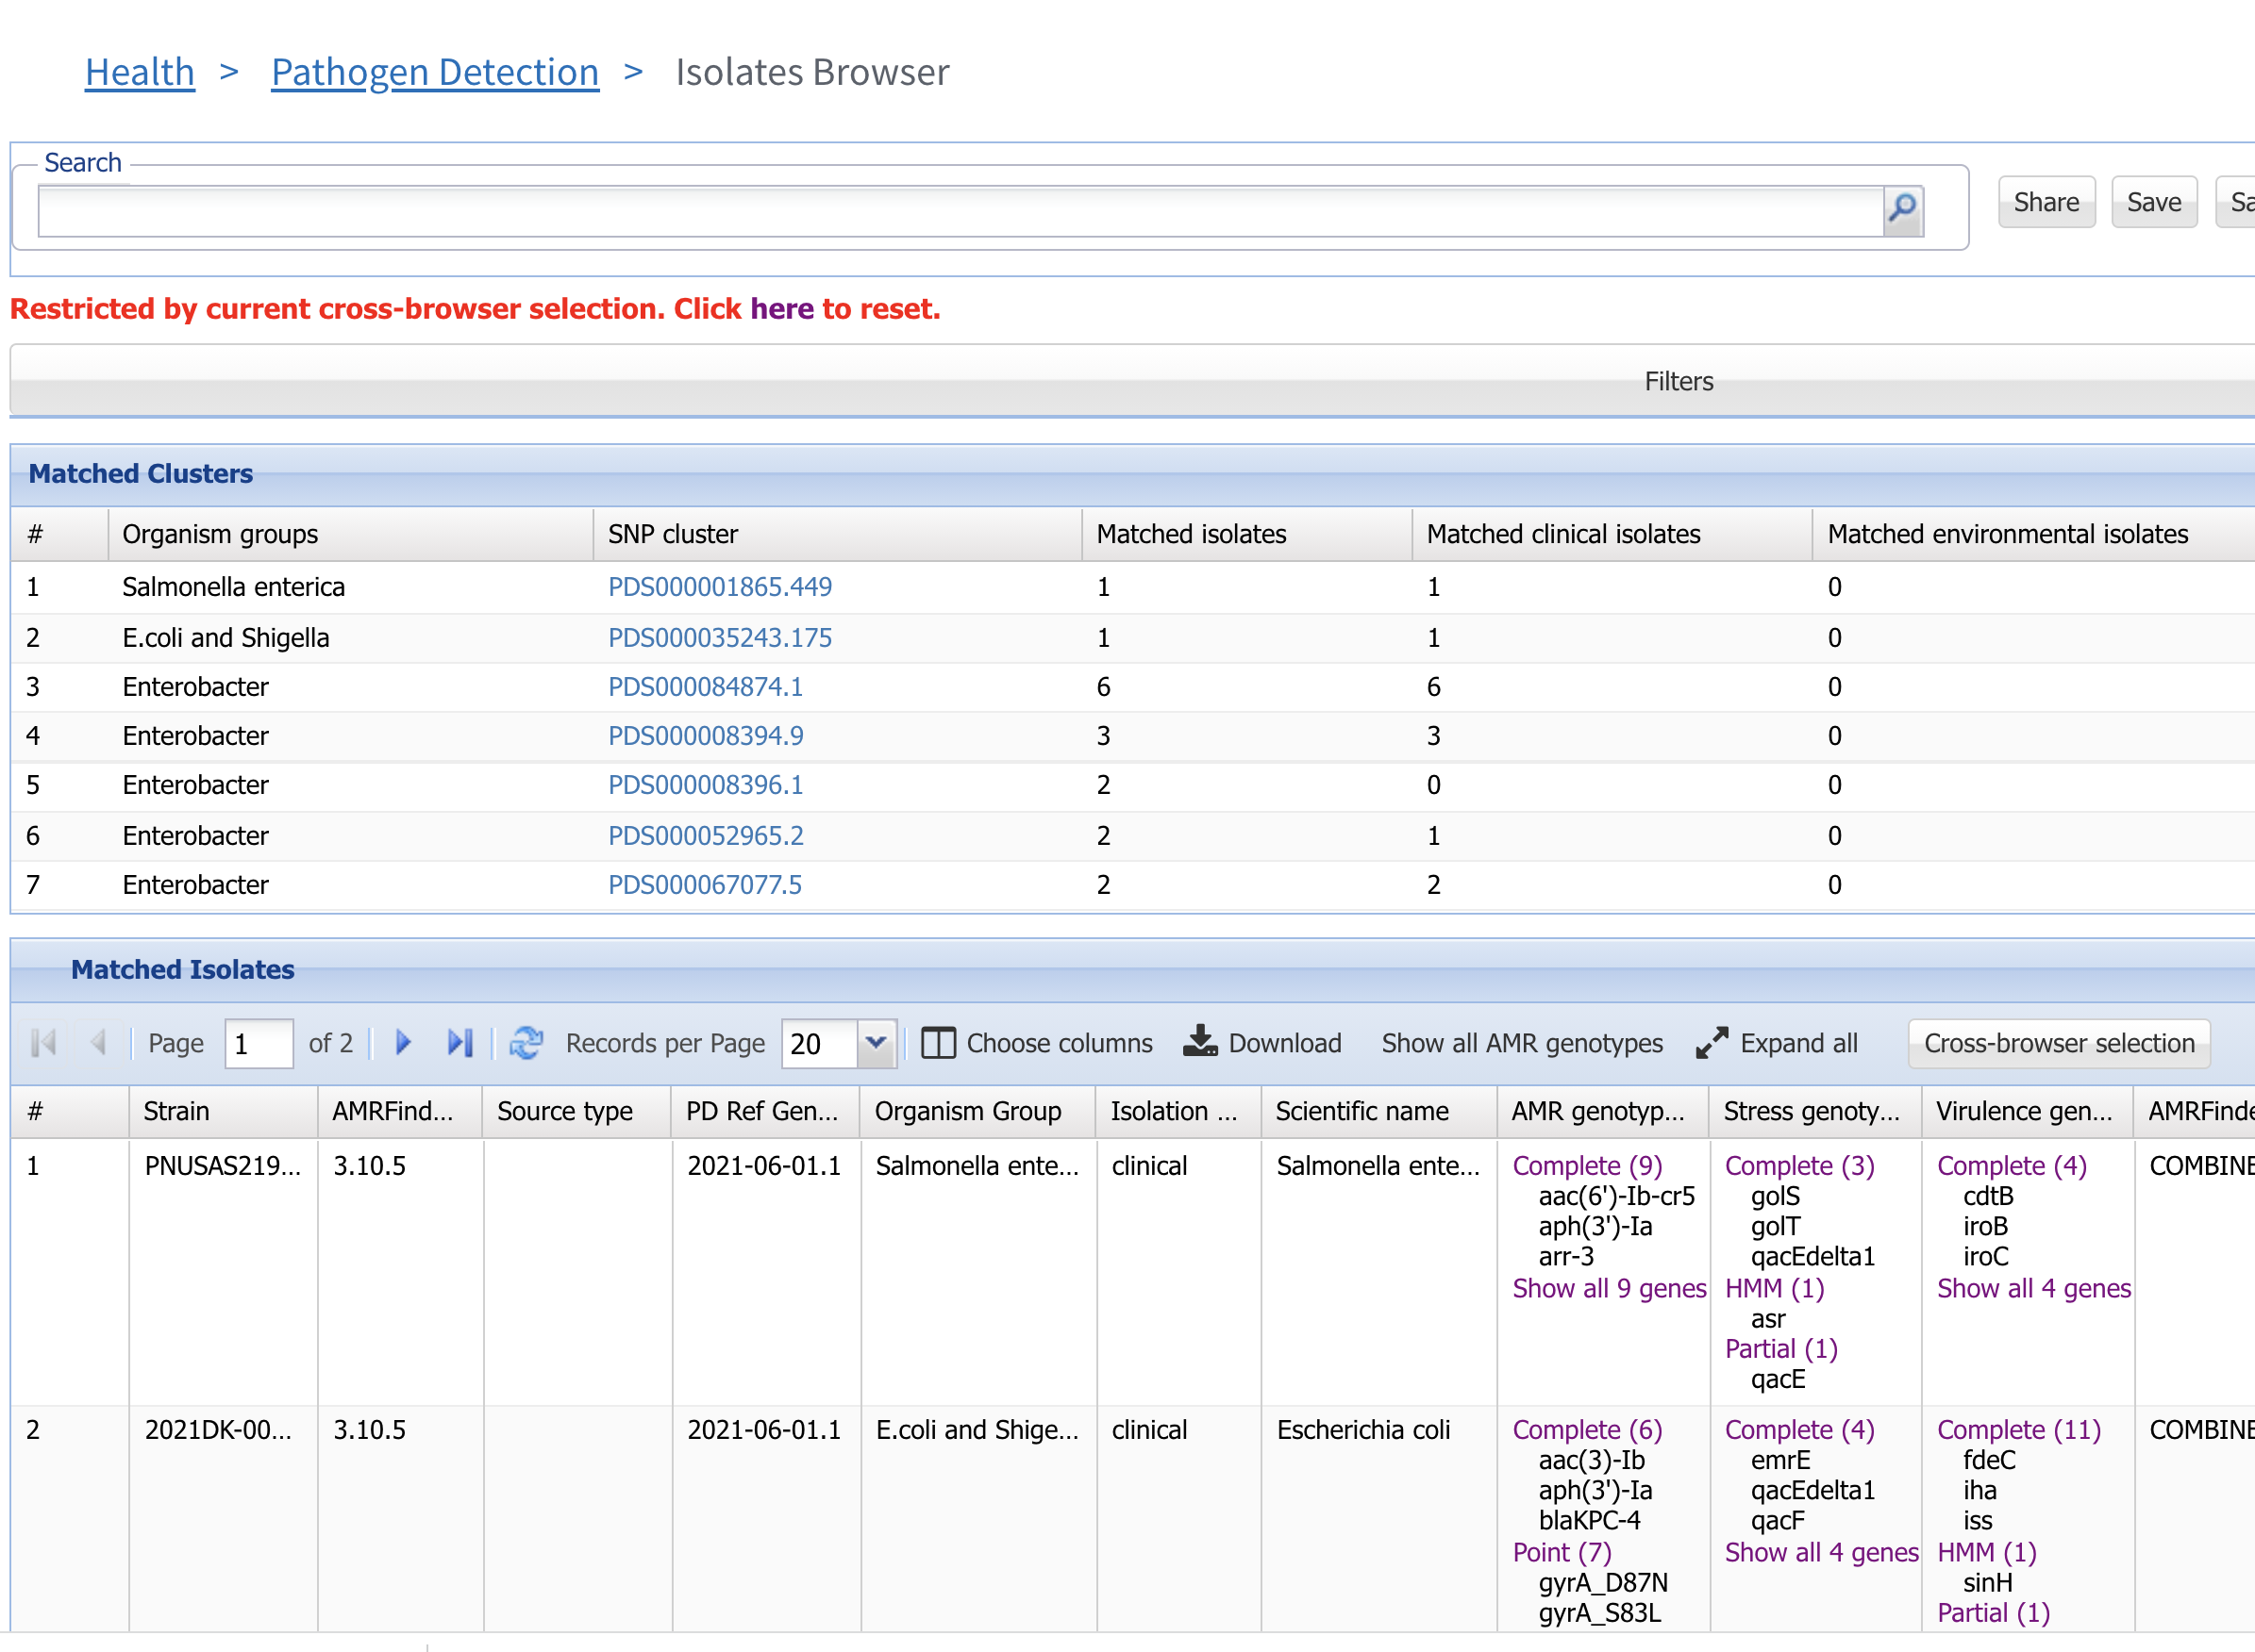
4. Select Download

Slide 6
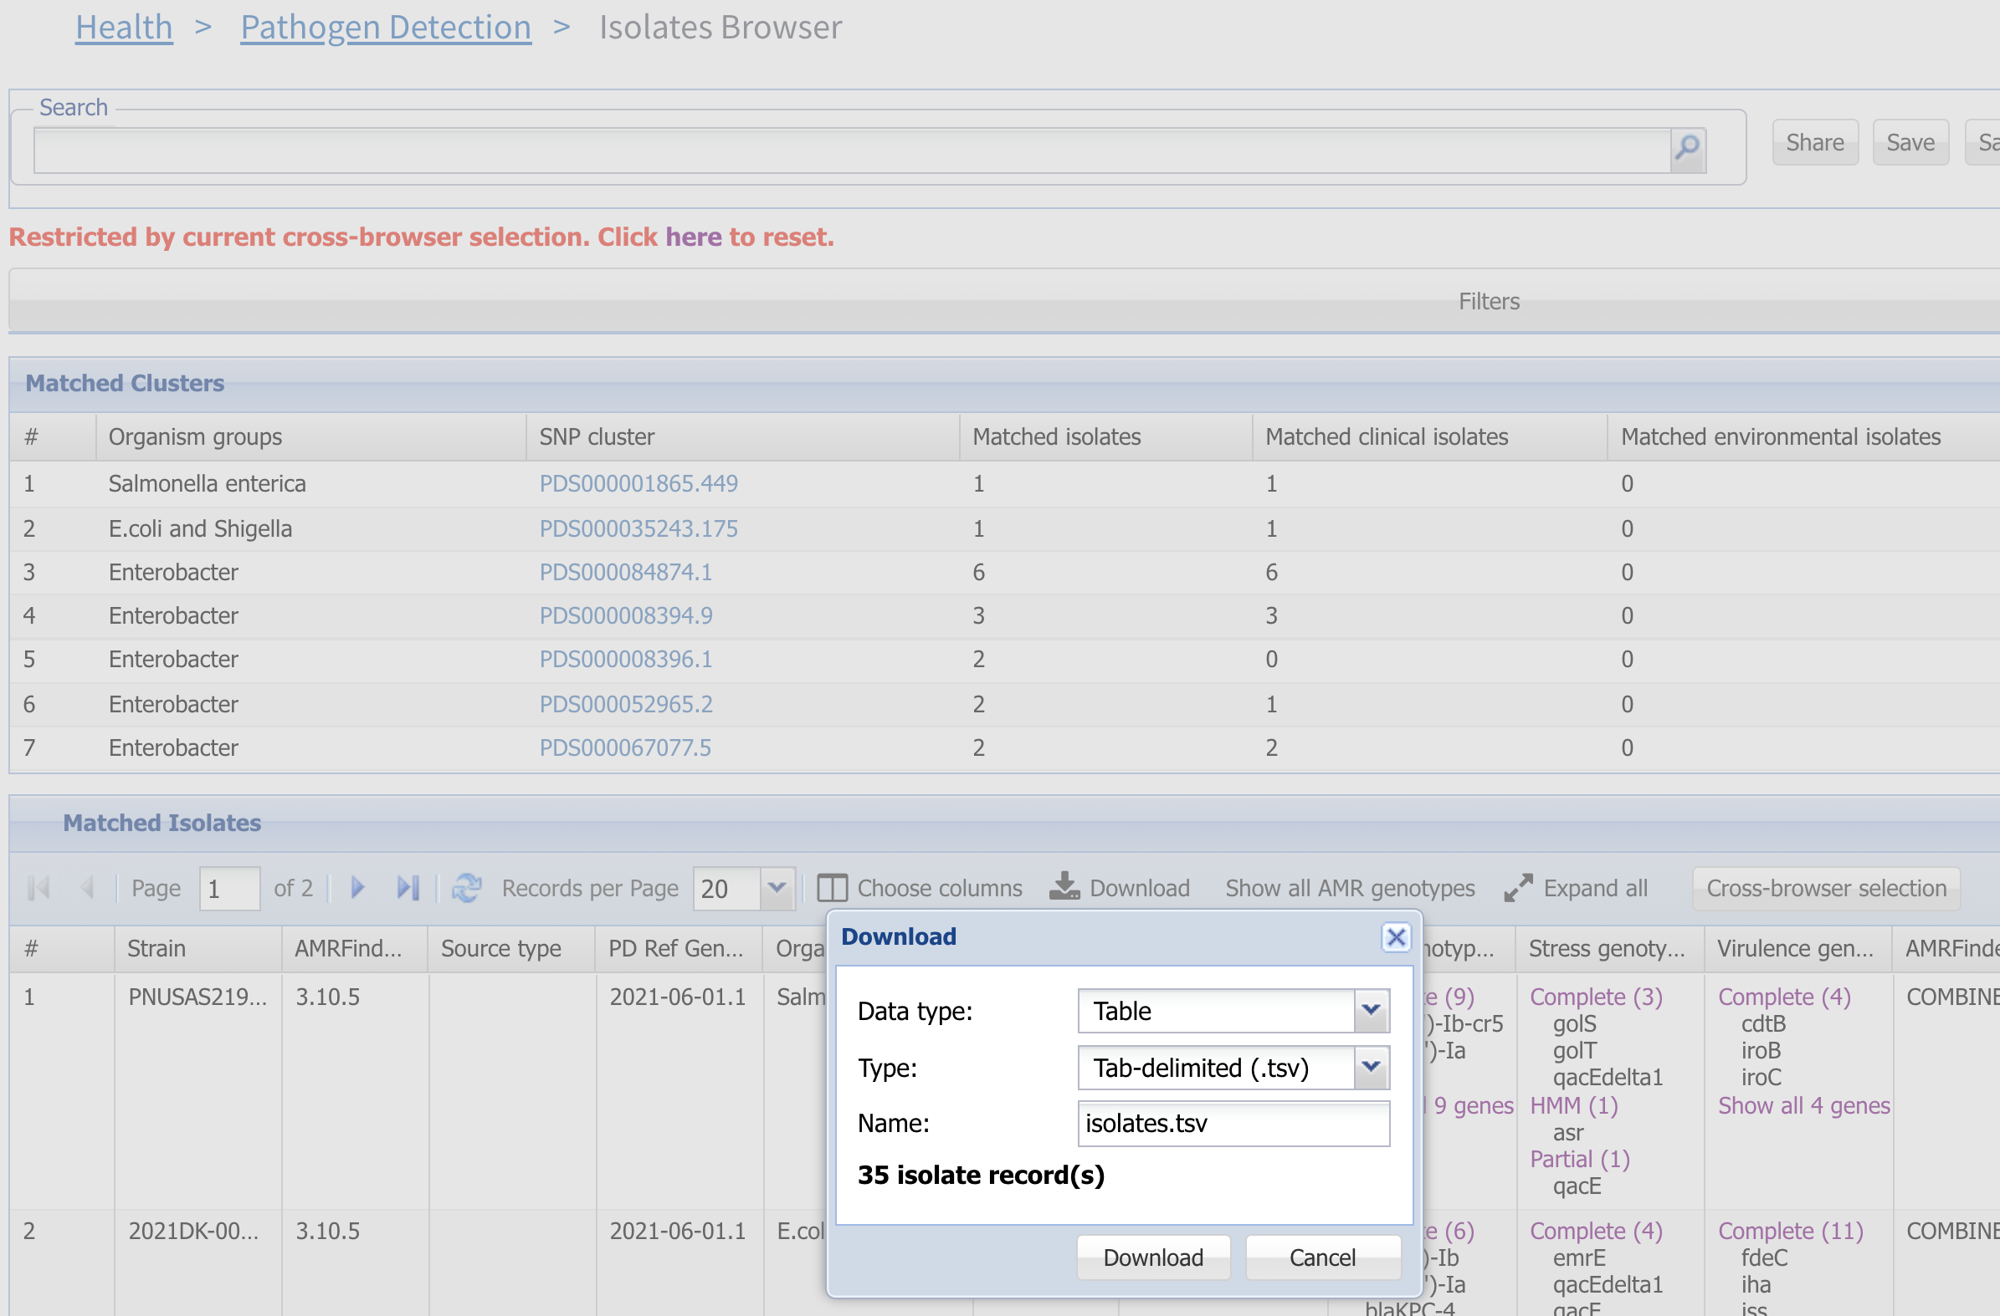
4. Select Download to download a tab-delimited table containing isolate information

Slide 7
More information
For full help documentation of the Reference Gene Catalog see: https://www.ncbi.nlm.nih.gov/pathogens/pathogens_help/#reference-gene-catalog
For details about filters see:
https://www.ncbi.nlm.nih.gov/pathogens/pathogens_help/#refgene-filters
For details about the table downloads see:
https://www.ncbi.nlm.nih.gov/pathogens/pathogens_help/#refgene-access-download
Questions and further help: email pd-help@ncbi.nlm.nih.gov

