Slide 1
How To: Identify carbapenem-resistant isolates without common acquired carbapenem resistance genes
NCBI Pathogen Detection https://www.ncbi.nlm.nih.gov/pathogens

Slide 2
At a glance
Use the Isolates Browser https://www.ncbi.nlm.nih.gov/pathogens/isolates
Use AST_phenotypes: and AMR_genotypes: search fields
Download table and/or assemblies
Use cross-browser selection to identify AMRFinderPlus results for those isolates
You can also use Filters to search

Slide 3
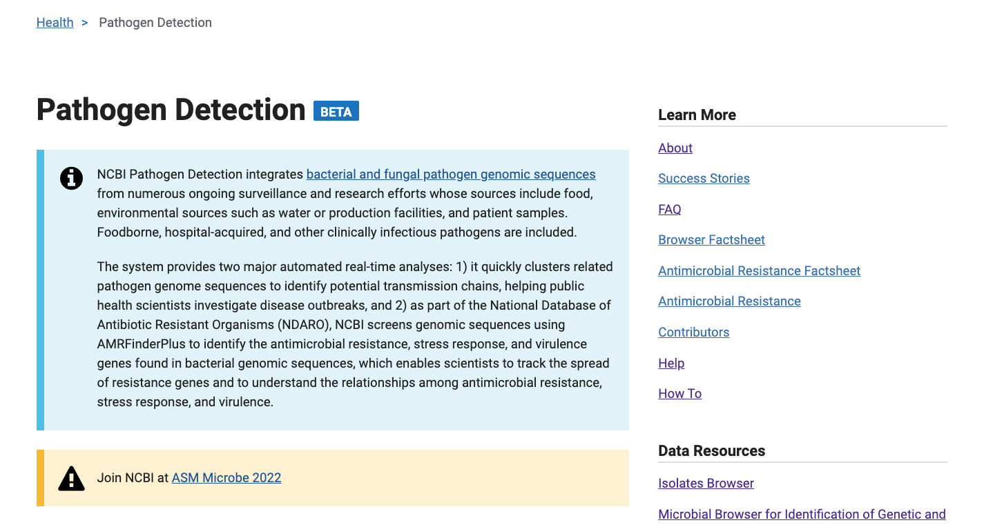
https://www.ncbi.nlm.nih.gov/pathogens
1. Click Isolates Browser

Slide 4
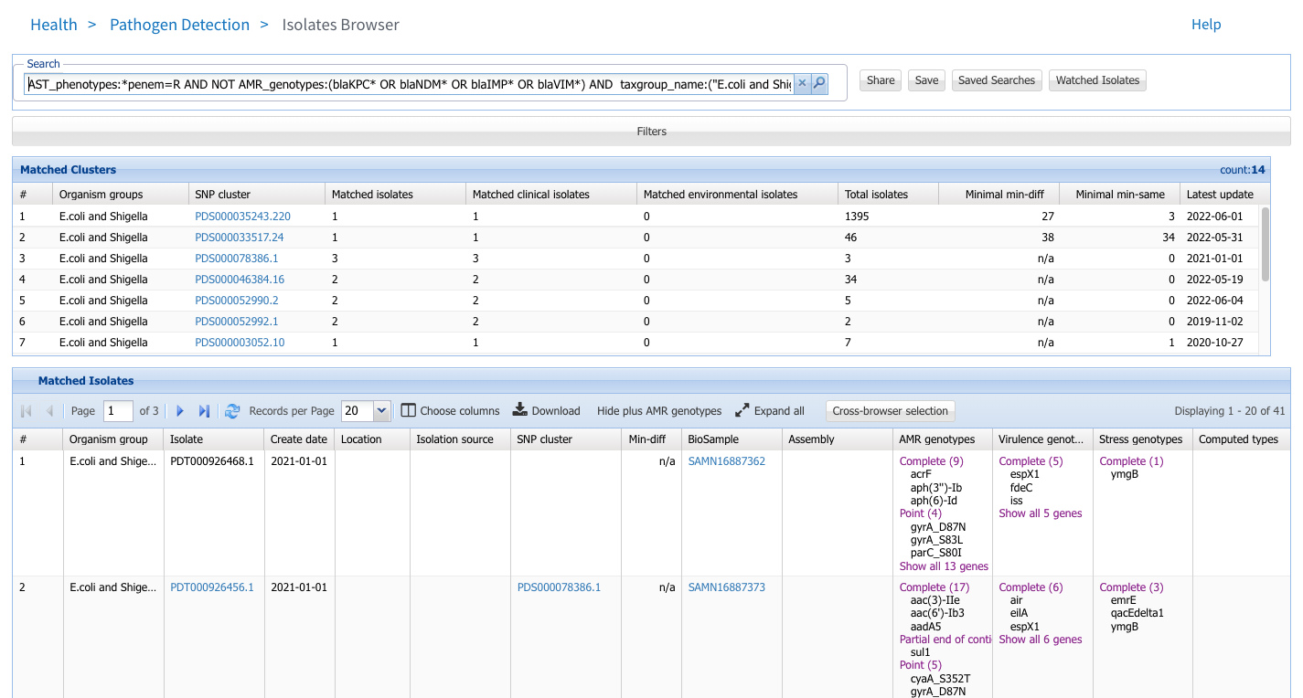
https://www.ncbi.nlm.nih.gov/pathogens/isolates
2. Enter search string using ‘AST_phenotypes:’ e.g.: AST_phenotypes:*penem=R AND NOT AMR_genotypes:(blaKPC* OR blaNDM* OR blaIMP* OR blaVIM*)
This will exclude all isolates with KPC, NDM, IMP, or VIM carbapenemases.
3. Download table of results and/or isolate assemblies
4. Use Cross-browser selection to view the results of AMRFinderPlus for these isolates in MicroBIGG-E

Slide 5
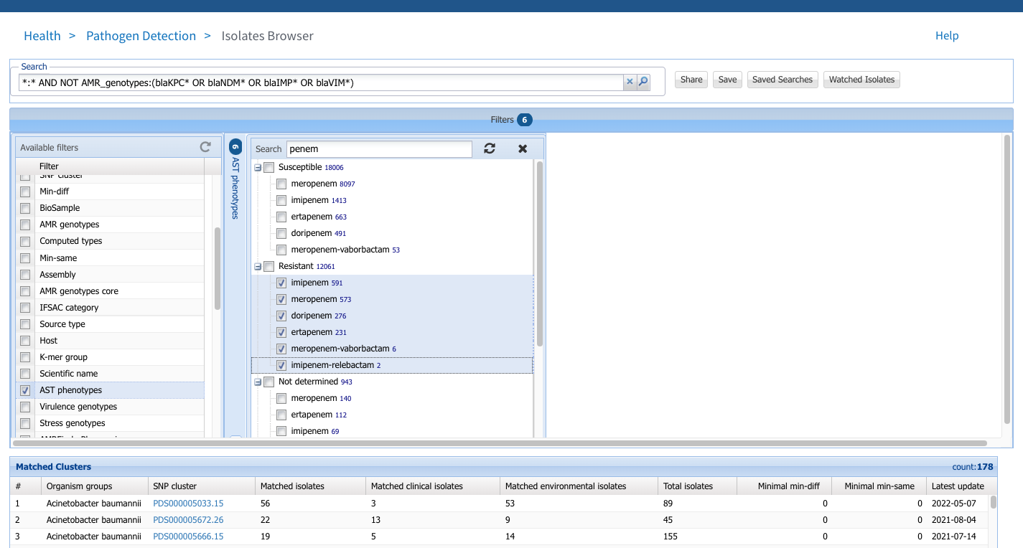
https://www.ncbi.nlm.nih.gov/pathogens/isolates
2. An alternative method of search is to use the filters feature. Click the bar to bring up filters
4. Use the substring search to identify the phenotypes of interest
5. Select the drugs under “Resistant” to select isolates tested resistant to those drugs.
3. Select the field you want to search

Slide 6
More information
For full help documentation of the Isolates Browser see: https://www.ncbi.nlm.nih.gov/pathogens/pathogens_help/#isolates-browser
For details about filters see: https://www.ncbi.nlm.nih.gov/pathogens/pathogens_help/#filters
For details about the solr search syntax used to search the browsers see: https://www.ncbi.nlm.nih.gov/pathogens/pathogens_help/#solr
Questions and further help: email pd-help@ncbi.nlm.nih.gov

